Slide 1
LJUBLJANA EUROPEAN GREEN CAPITAL 2016
Nataša Jazbinšek Seršen
City of Ljubljana
Head of Department of Environmental Protection

Slide 2
The „European Green Capital“ award is a European Commission initiative under which each year a group of environmental experts and a jury name one city as the European Green Capital.
12 indicators of sustainable development
Notes:
sdfk

Slide 3
12 indicators of sustainable development
climate change,
local transport,
green urban areas incorporating sustainable land use,
nature and biodiversity,
quality of the local ambient air,
quality of the acoustic environment,
waste production and management,
water consumption,
waste water management,
environmental innovation and sustainable employment,
energy efficiency,
environmental management by local authorities.
Notes:
sdfk

Slide 4
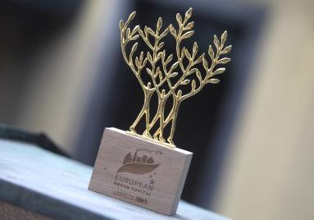
The award was
received
in June 2014
Notes:
sdfk

Slide 5
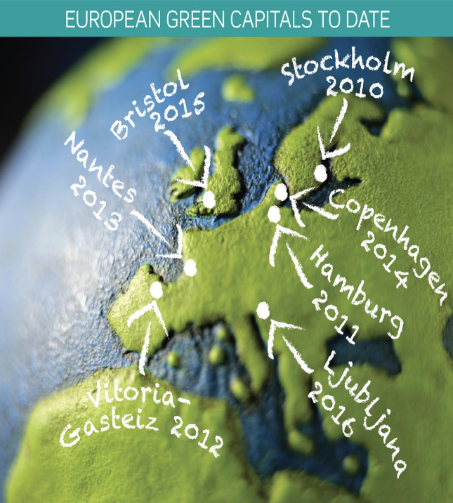
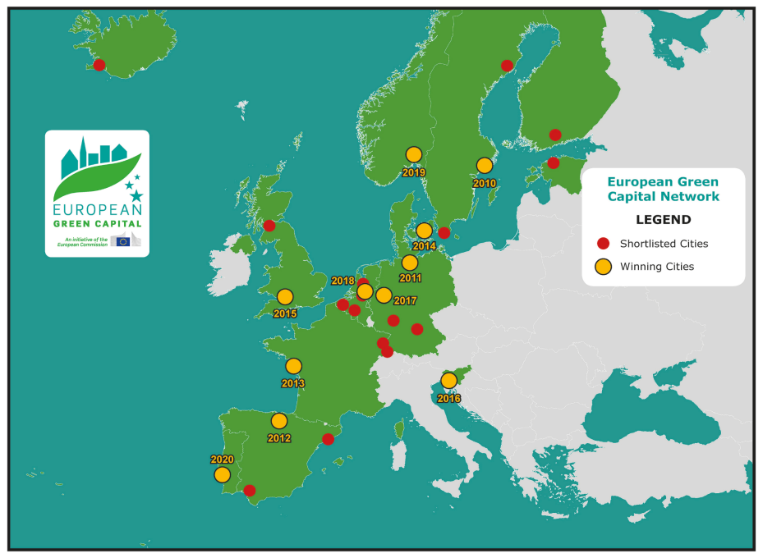
Notes:
sdfk

Slide 6
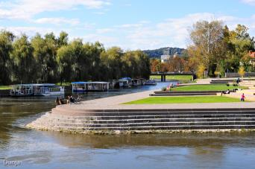
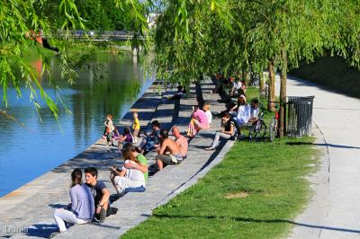
Vision Ljubljana 2025 (2007)
Ideal City
Development of the City with respect to its history
Metropolis
Quality of life, safety and tolerance
Environmentally friendly city
City in harmony with the nature

Slide 7
Why has Ljubljana become European Green Capital 2016?

Slide 8
1. Green identity of the City

Slide 10
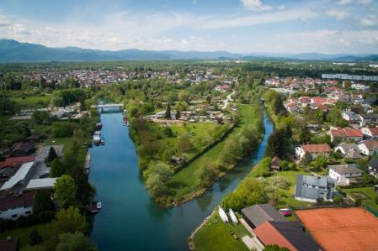
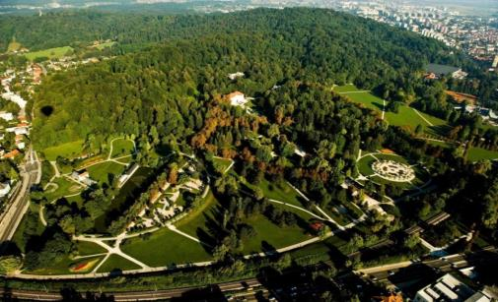
Green identity of the City
Green areas = ¾ of the city‘s surface
542 m² public green area per
inhabitant
4 landscape parks
(13,8 % city‘s surface)
1.200 ha of special-purpose forest
20 % of the city‘s area has
a nature protection status
Natura 2000 areas: 16,5 %

Slide 11
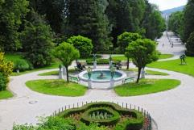
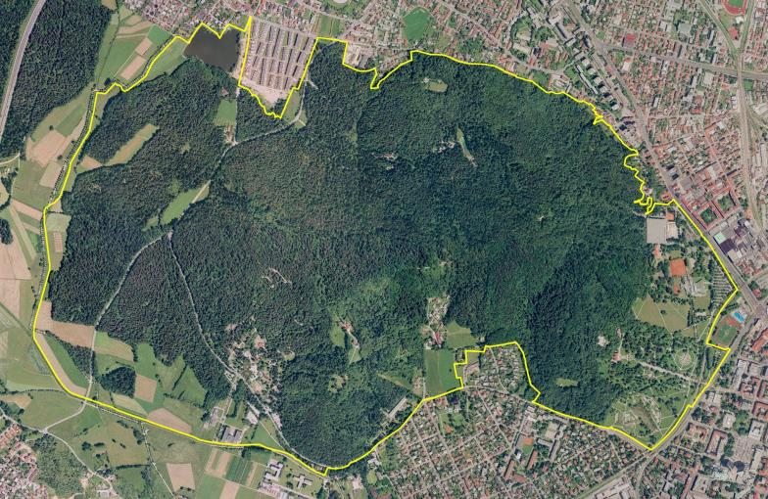
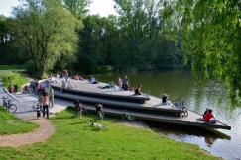
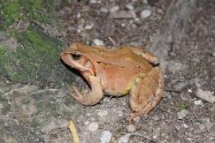
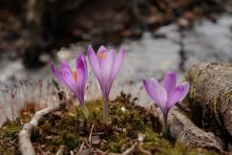
Green identity of the City
Landscape park Tivoli, Rožnik in Šišenski hill

Slide 12
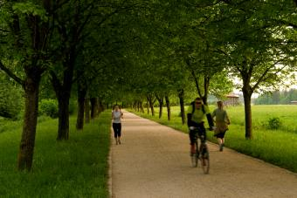
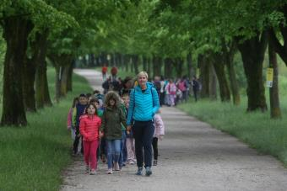
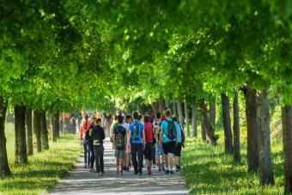
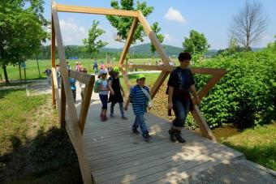
The Path of Remembrance and Comradeship

Slide 13
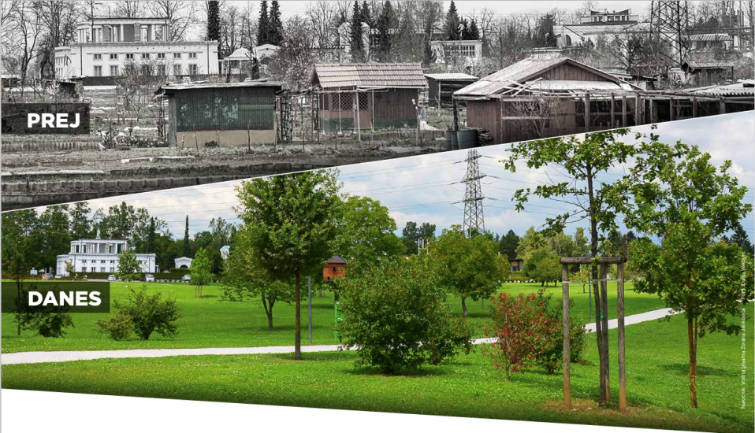
Renovation of degraded areas and transform them into green spaces
BEFORE
NOW

Slide 14
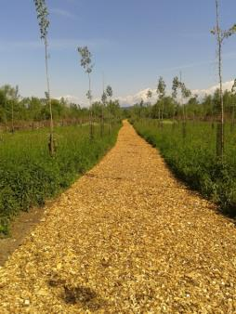
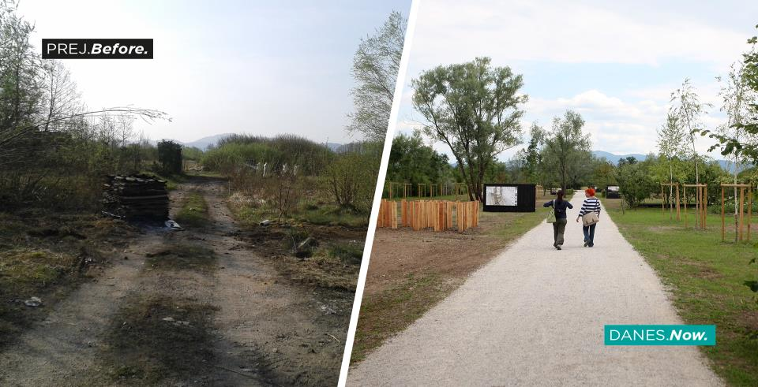
Renovation of degraded areas and transform them into green spaces

Slide 15
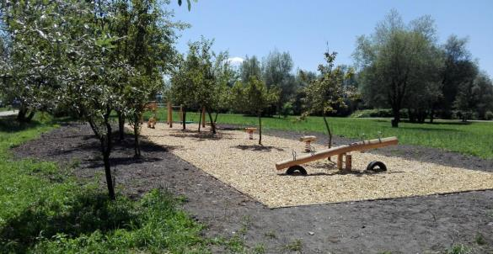
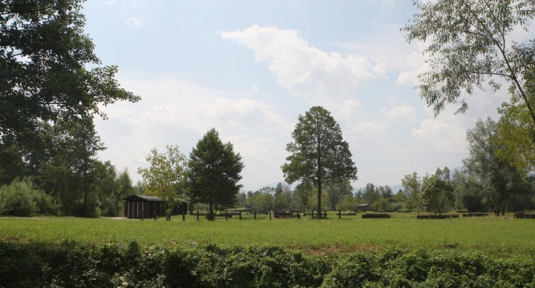
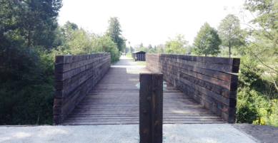
Renovation of degraded areas and transform them into green spaces

Slide 16
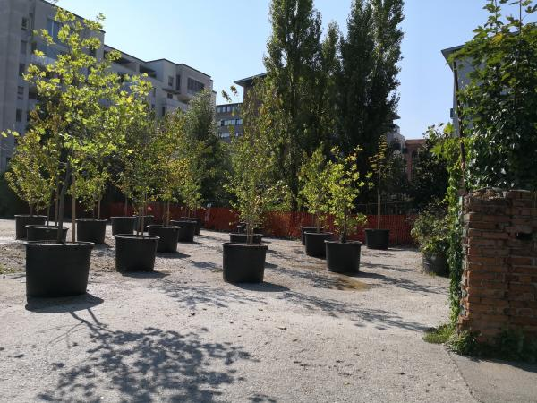
Renovation of degraded areas and transform them into green spaces

Slide 17
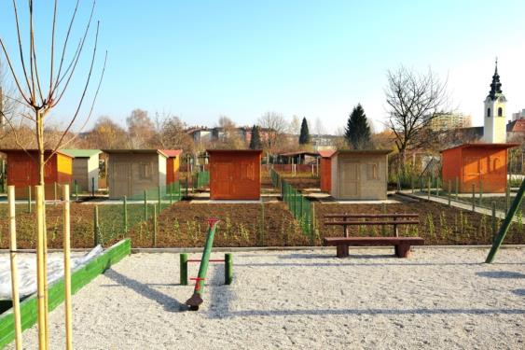
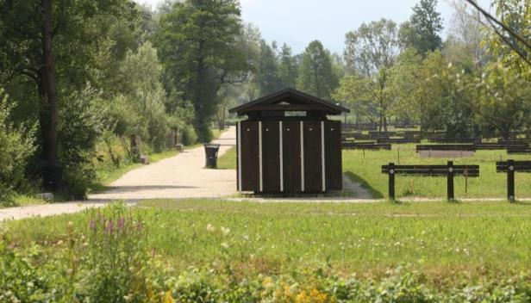
Urban gardening and local self-sufficiency

Slide 18
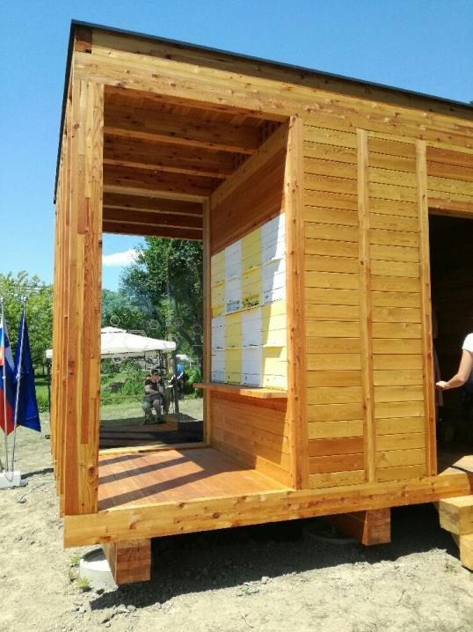
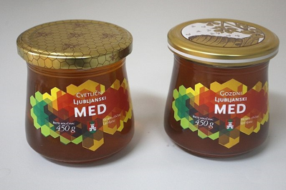
Beekeeping has a rich tradition in Ljubljana

Slide 19
2. Ecological Zone in the City Centre

Slide 20
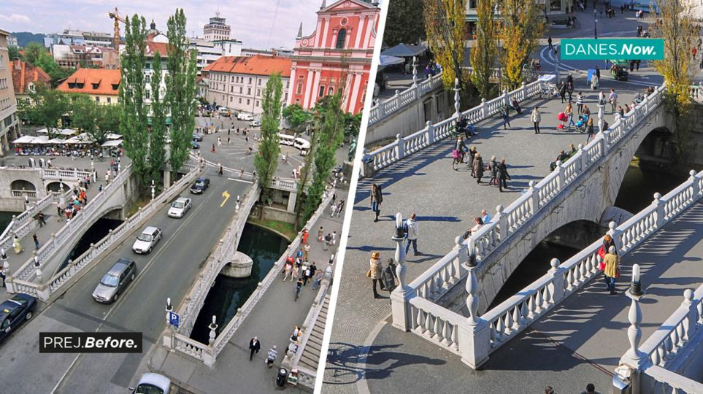

Slide 21
Before
Now

Slide 22
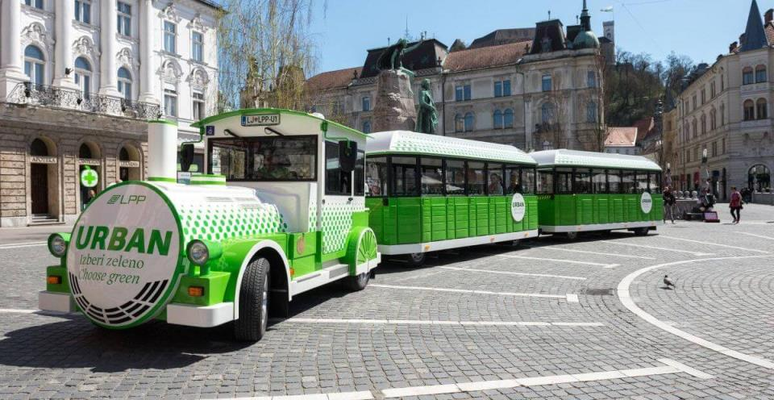
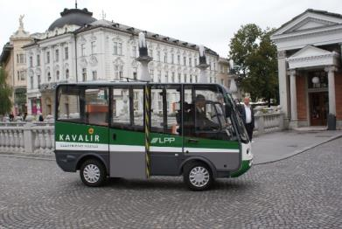
Ecological Zone – green oasis in the city centre

Slide 23
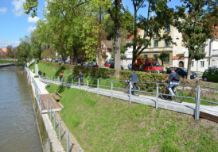
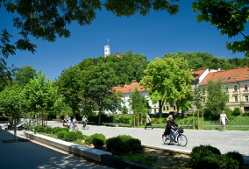
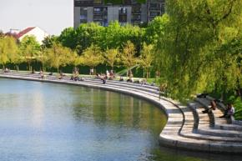
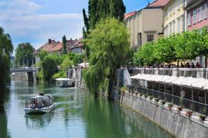
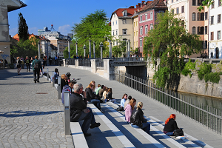
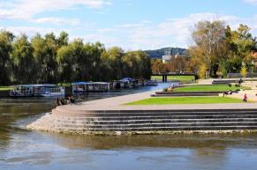
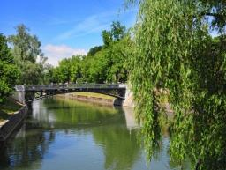
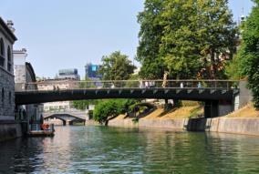
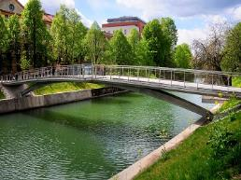
Refurbishment of the Banks and the Bridges of the River Ljubljanica

Slide 24
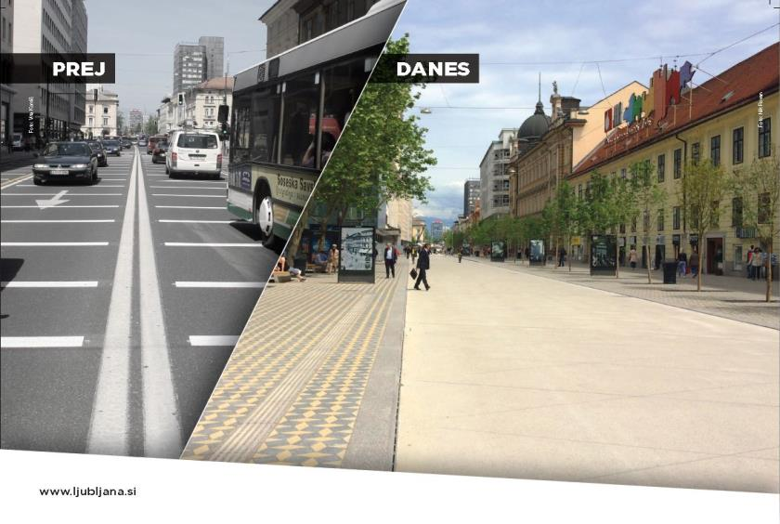
New traffic regime in the main traffic artery Slovenska street „shared space“
Before
Now

Slide 25
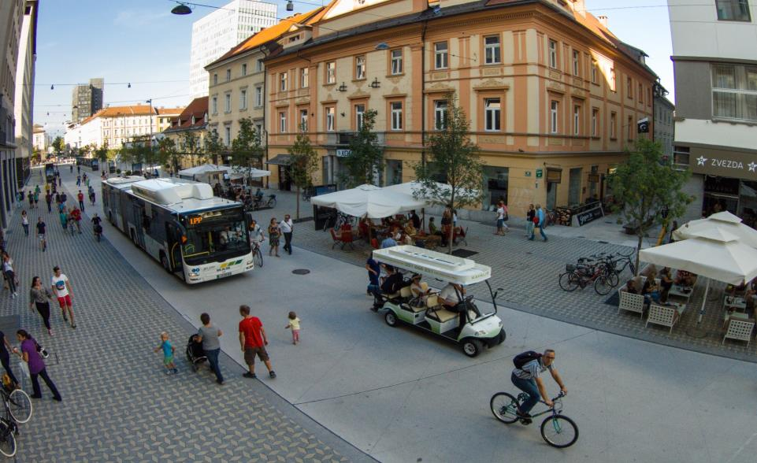
New traffic regime in the main traffic artery Slovenska street „shared space“

Slide 26
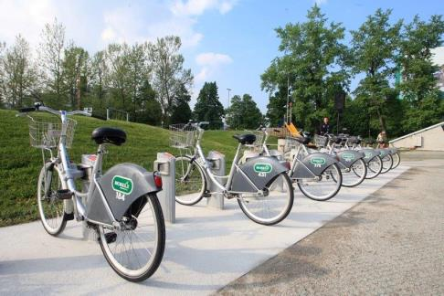
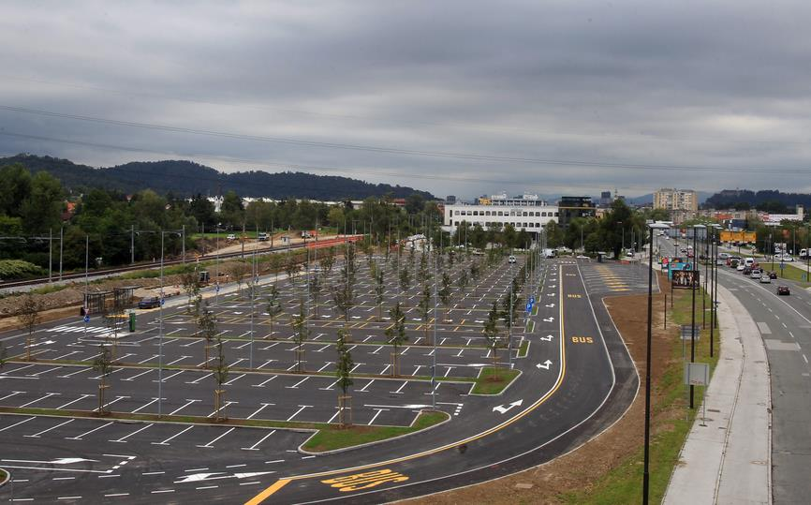
Sustainable mobility

Slide 27
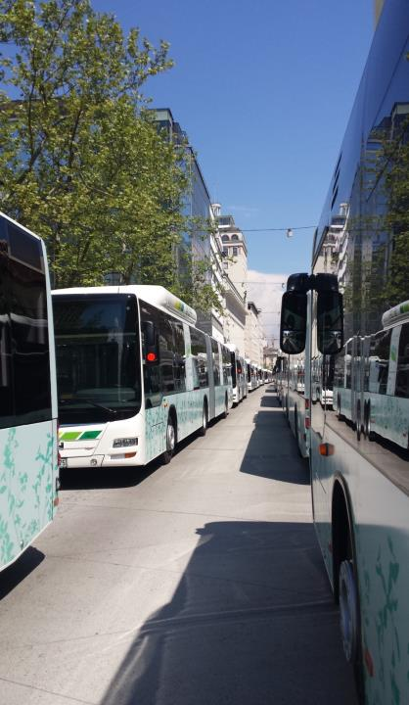
Sustainable mobility

Slide 28
3. Sophisticated waste management system

Slide 29
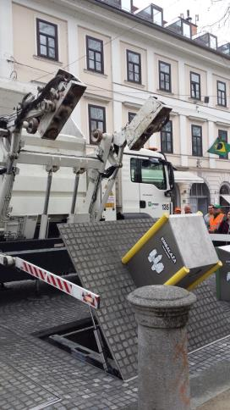
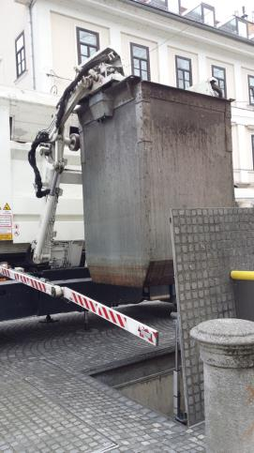
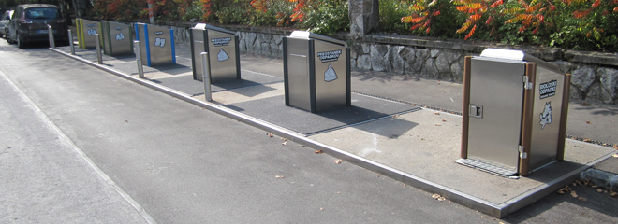
Separate waste collection, underground waste units

Slide 30
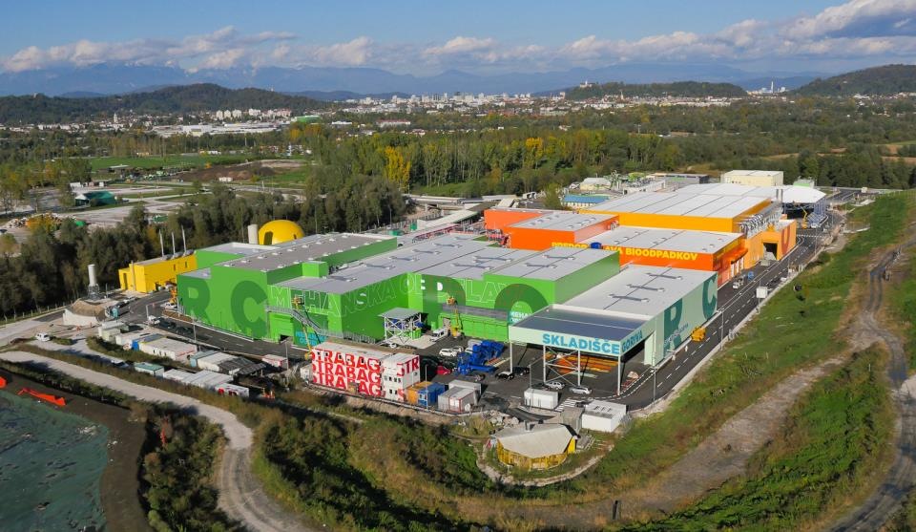
The Regional Waste Managemnet Centre upgrade is the largest EU cohesion and environmental project in Slovenia

Slide 31
4. Natural drinking water

Slide 32
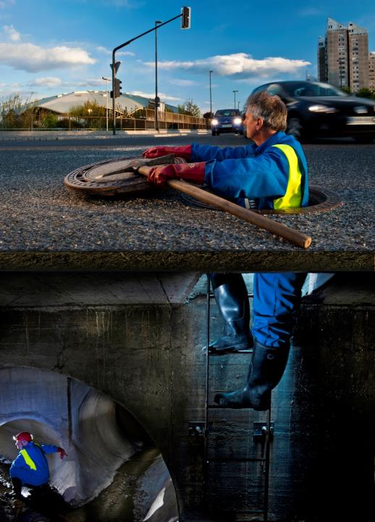
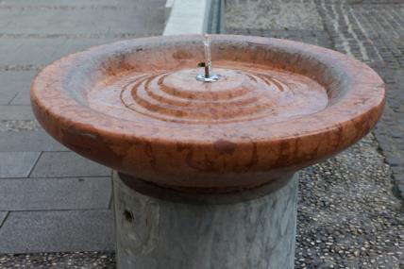
Ljubljana can boast potable tap water that is not treated with technological processes

Slide 33
Towards circular economy

Slide 34
Among the first in the world to produce paper out of Japanese knotweed

Slide 36
Processing Japanese knotweed into paper

Slide 38
Against plastic bags at Ljubljana‘s markets
„I‘M NOT LASTING, BUT THEREFORE LESS ANNOYING. I‘M BIODEGRADABLE BAG.“

Slide 39
First self – service bulk product vending machine Bert

Slide 40
Each member of the „big city‘s family“ planted their own tree – 12.089 new trees in Ljubljana - European Green Capital

Slide 41
Vision
Courage
Cooperation
Knowledge
Notes:
sdfk

Slide 42
Thank you for your
attention

